Slide 1
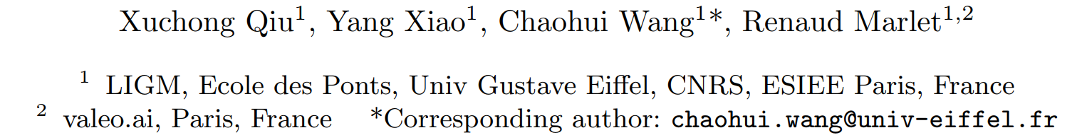
﻿﻿﻿ ﻿Pixel-Pair Occlusion Relationship Map (P2ORM): Formulation, Inference & Application

Slide 2
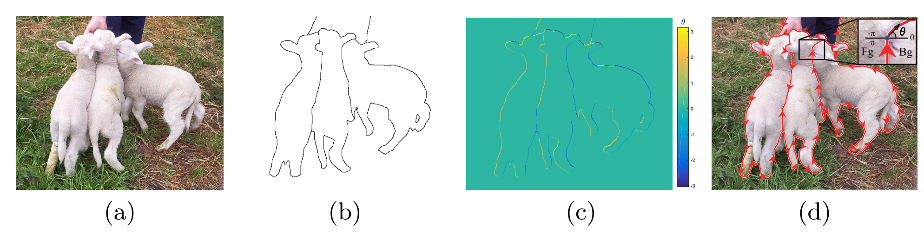
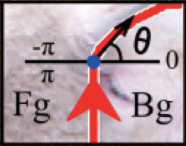
Occlusion Reasoning
Definition: Reasoning the occlusion relationship in scene image

Slide 3
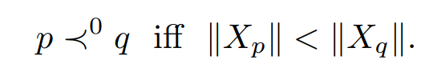
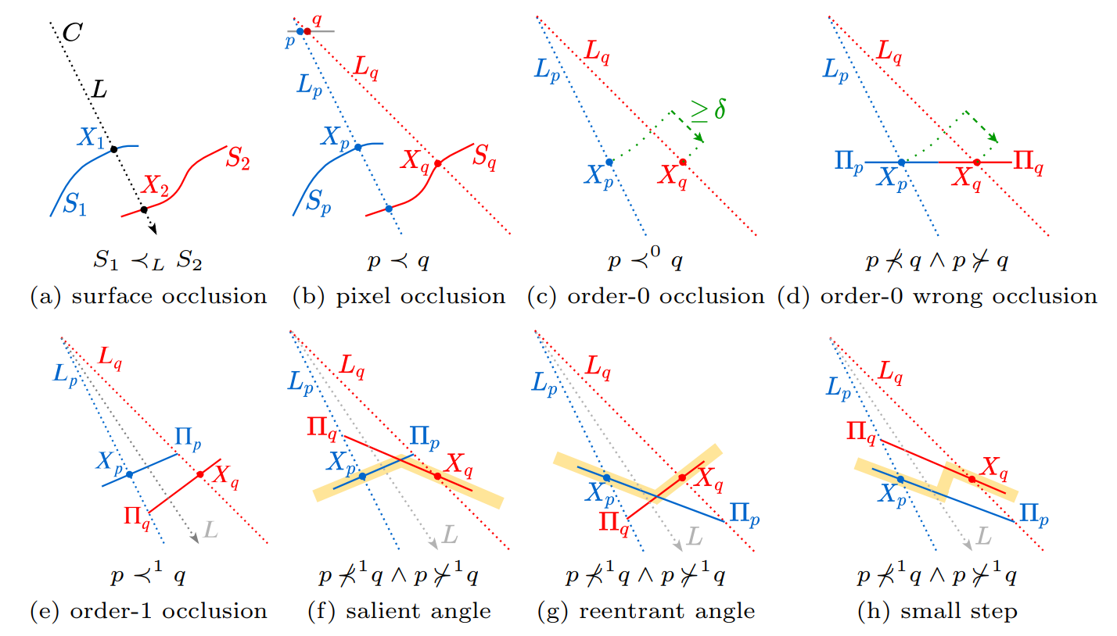
Formulation
Approximating occlusion at order 0

Slide 4
Formulation
Approximating occlusion at order 0

Slide 5
Formulation
Approximating occlusion at order 1

Slide 6
Formulation
Approximating occlusion at order 1

Slide 7
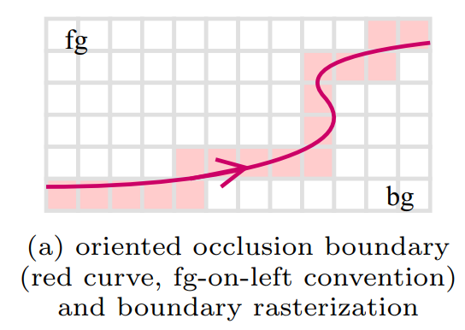
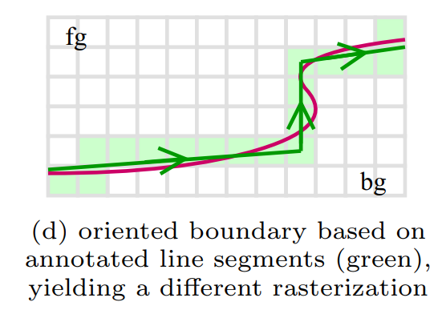
Method
Discretized occlusion

Slide 8
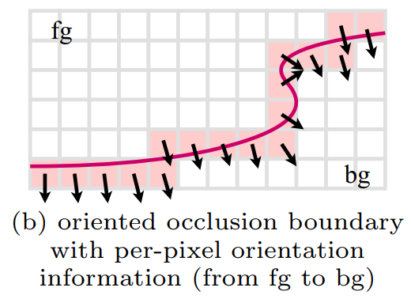
Method
Discretized occlusion

Slide 9
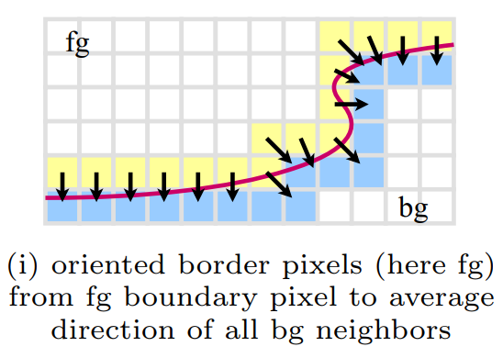
Method
Discretized occlusion

Slide 10
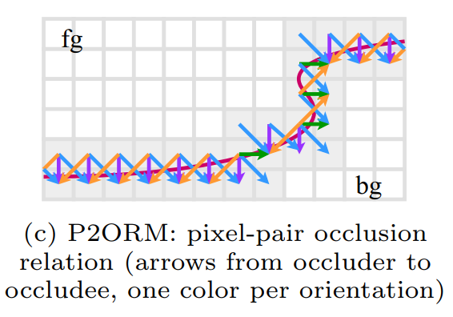
Method
Discretized occlusion
A
A

Slide 11
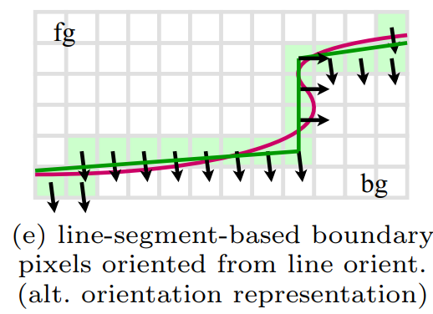
Method
Definition application

Slide 12
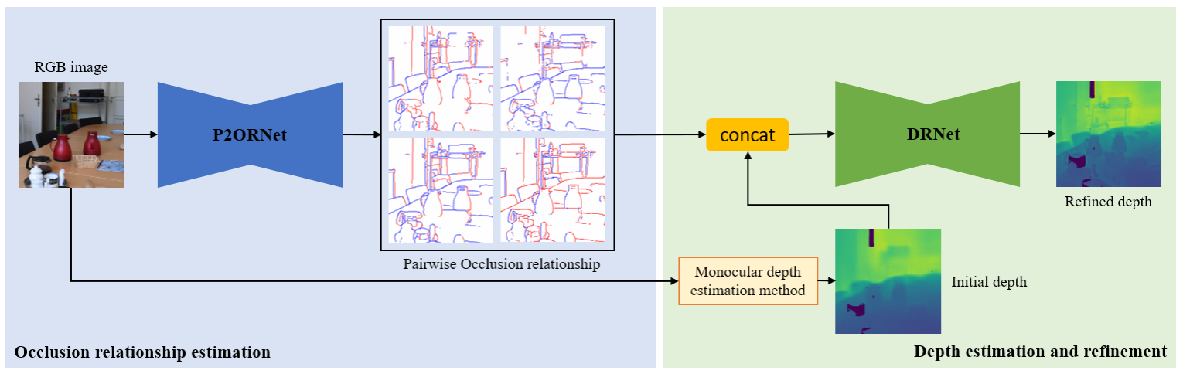
Method
Network Architecture
Modeling as classification task

Slide 13
Method
Application

Slide 14
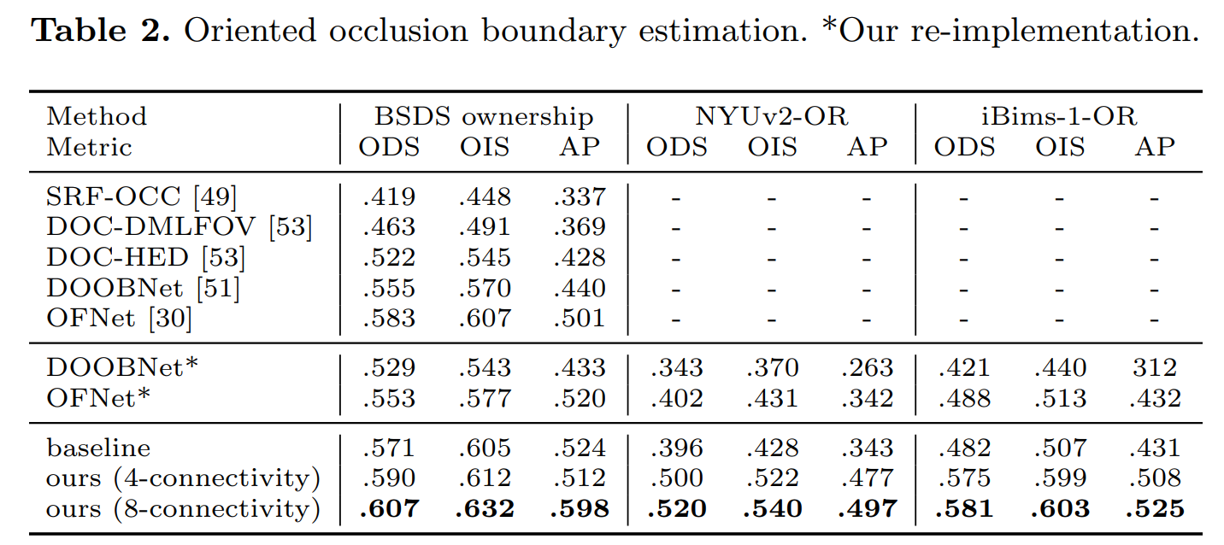
Result
Quantitive evaluation of occlusion reasoning

Slide 15
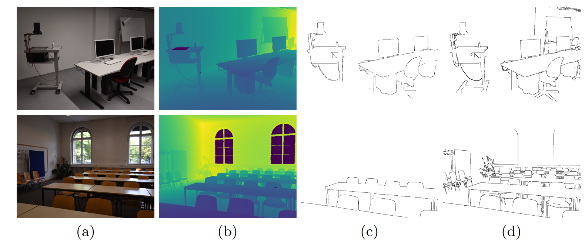
Result
Qualititive visualization of occlusion boundary

Slide 16
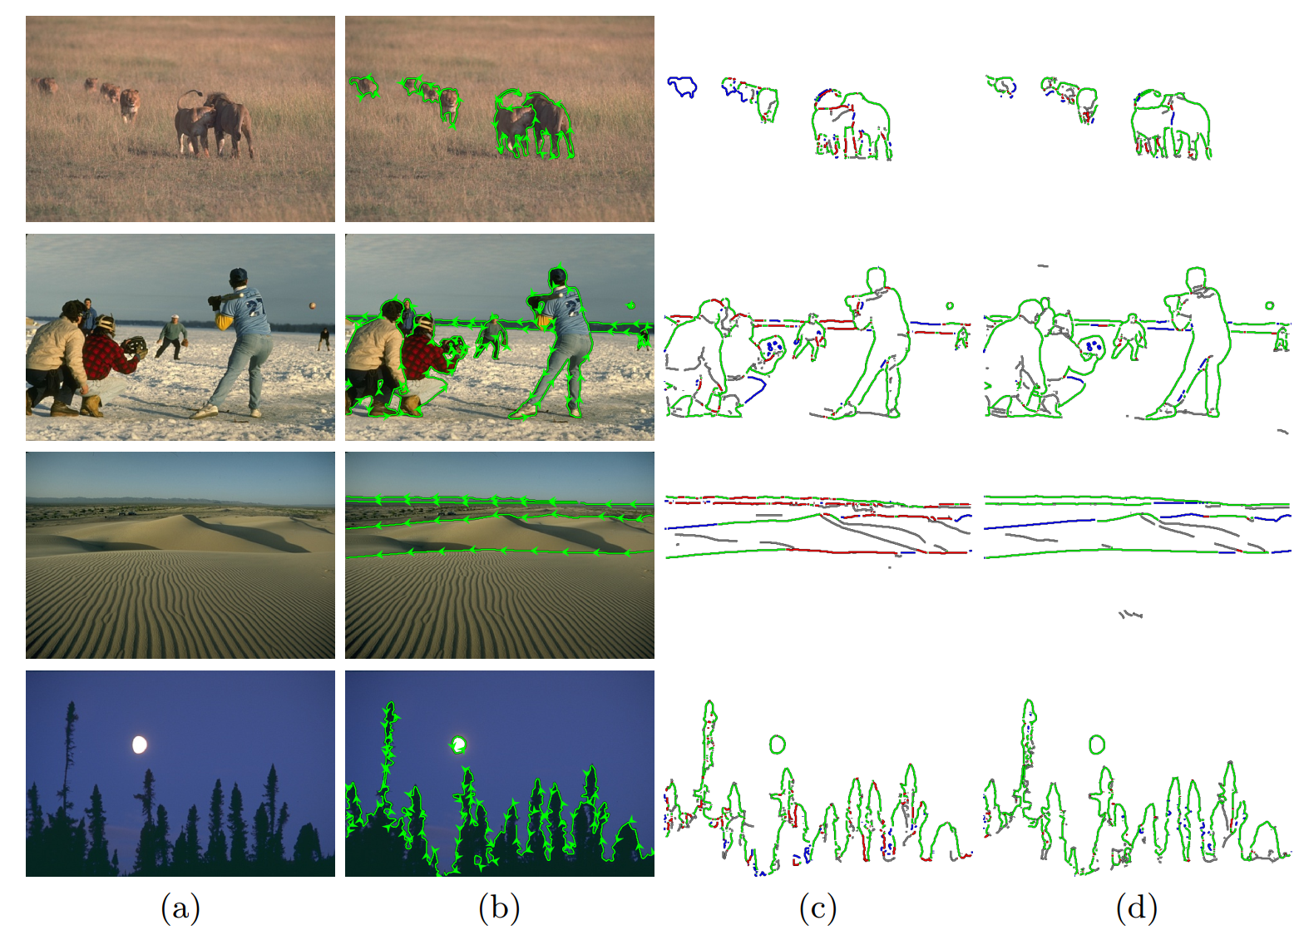
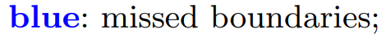
Result
Qualititive visualization of occlusion reasoning

Slide 17
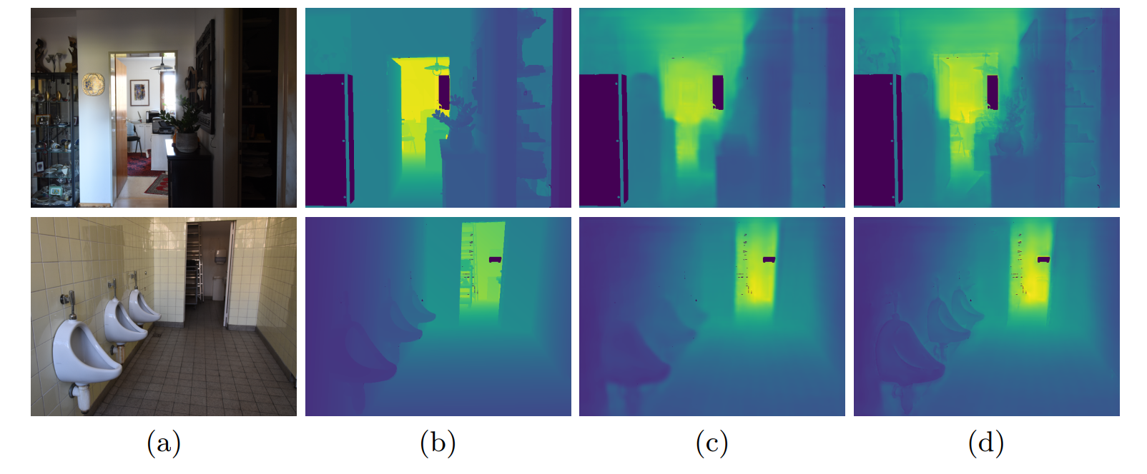
Result
Qualititive visualization of depth estimation refinement

Slide 18
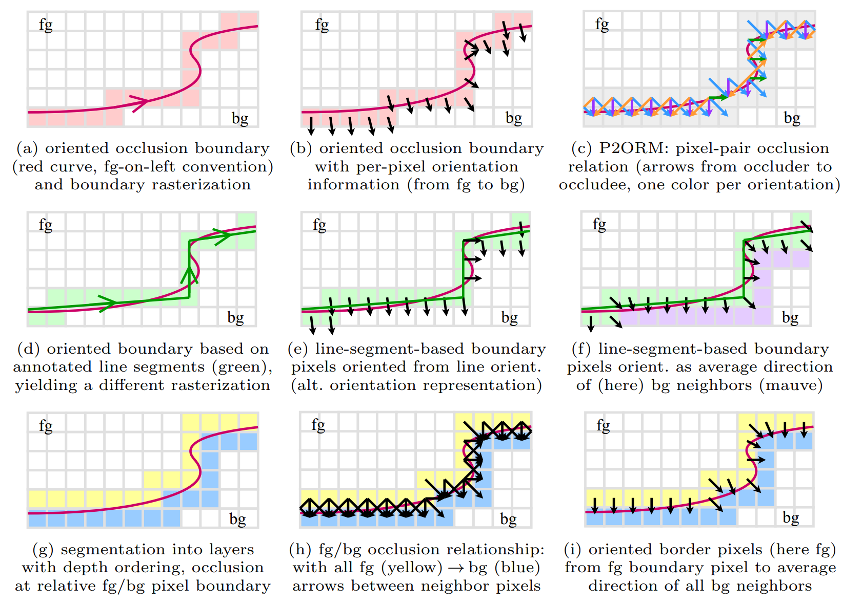
﻿Main Contribution
(1) A survey of occlusion boundary
﻿

Slide 19
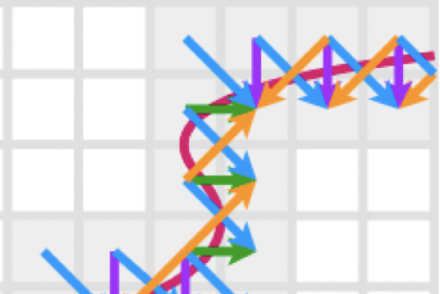
﻿Main Contribution
(1) A New definition of pixel-pair occlusion relationship
﻿
It’s unnessesary to use a continuous angle value (-π, +π) to define occlusion
For d﻿iscretized pixels, the chances is limited

